Slide 1
Welcome
New Parents Meeting
18th September 2023

Slide 2
Castlefield School Ethos
Castlefield School Curriculum Offers
Learning for Life
Experience
& Enrichment
‘No Excuses’

Slide 3
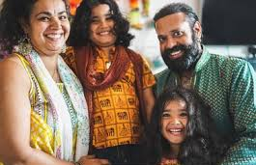
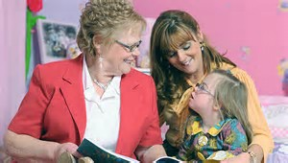
Parents as Partners in Learning
&

Slide 4
School Structure
Who do I speak to?
Mr. A. Kann
Head Teacher
Mrs. P. Sohal
Early Years Phase Leader
Mrs M Hywood
Nursery
2-3 Year Old
Room Leader
Ms J MacIver
Nursery
Class Teacher
Nursery Lead
Mrs C Lottering
Reception
Class Teacher
Reception Lead
Mrs C Beaumont
Reception
Class Teacher
Early Years Foundation Stage Team

Slide 5
Attendance
Every day counts.
Morning Session 8:45-11:45
Afternoon Session 12:30- 3:30

Slide 6
What will my child learn whilst at Nursery?

Slide 7
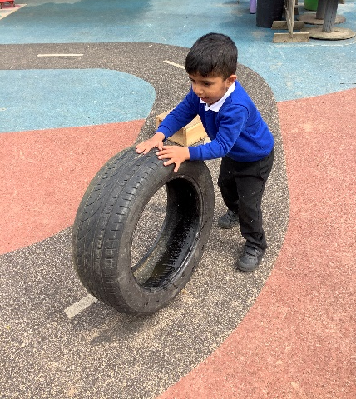
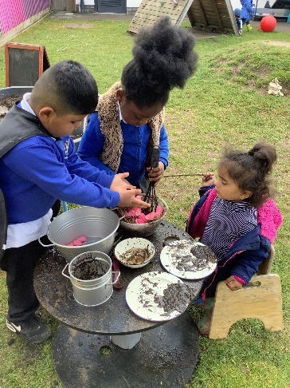
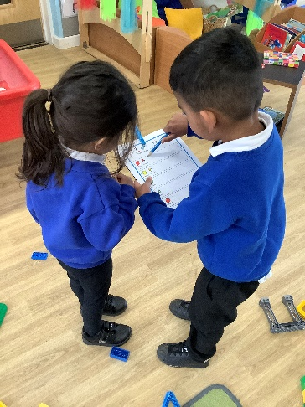
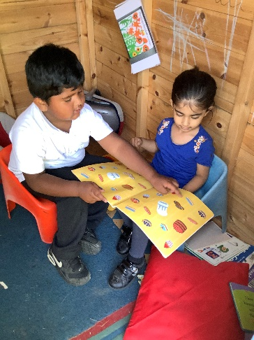
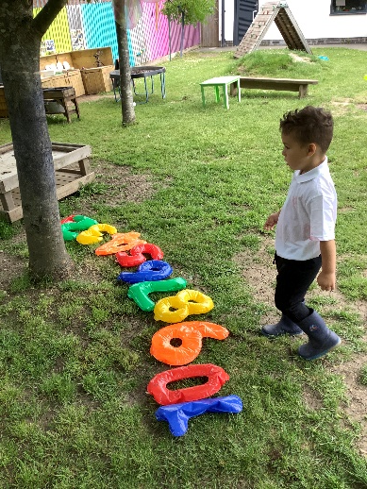
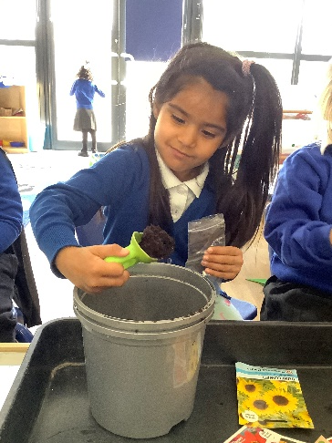
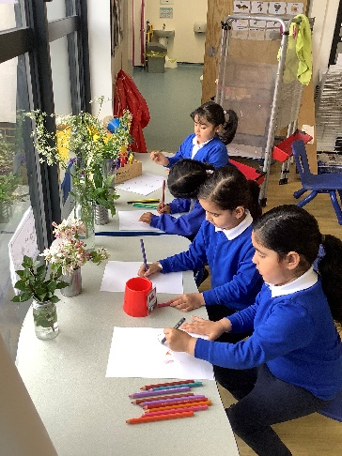
Personal, Social & Emotional Development
Communication & Language Development
Physical Development
Literacy
Maths
Understanding the World
Expressive Arts & Design

Slide 8
Curriculum
Topics
Amazing Me All Around the World
Who Can Help Me? Feathers and Fur
Let’s Get Growing Once Upon A Time…
https://www.gov.uk/government/publications/early-years-foundation-stage-framework--2
https://www.gov.uk/government/publications/development-matters--2

Slide 9
What will my child do whilst at Nursery?

Slide 10
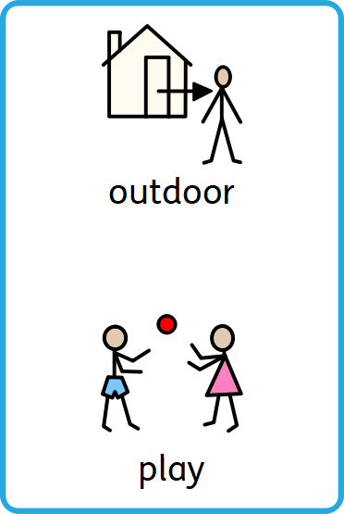
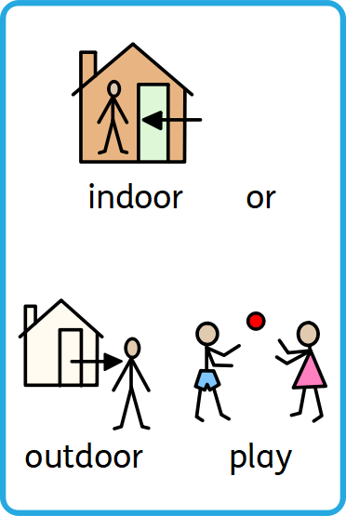
A Day in Nursery
2-3 Year Olds

Slide 11
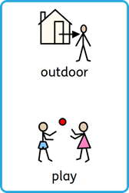
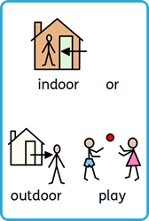
A Day in Nursery
3-4 Year Olds
self-registration

Slide 12
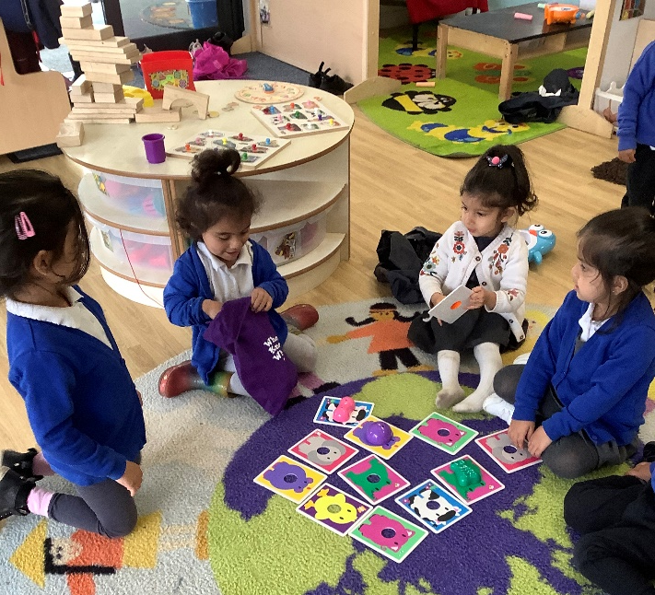
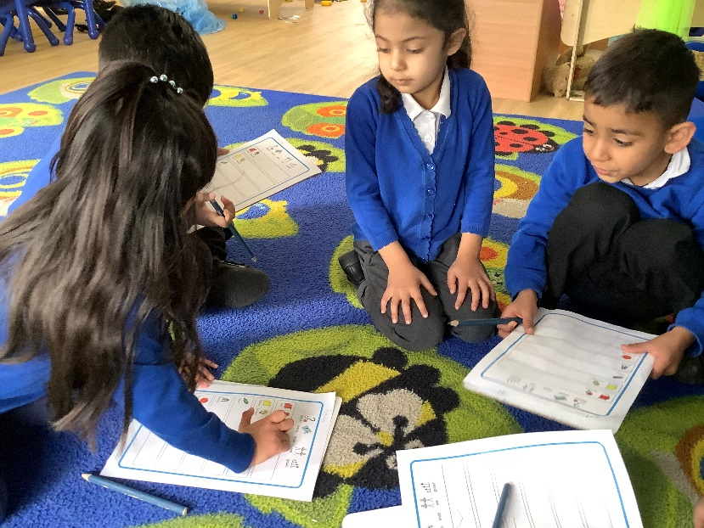
Group work

Slide 13
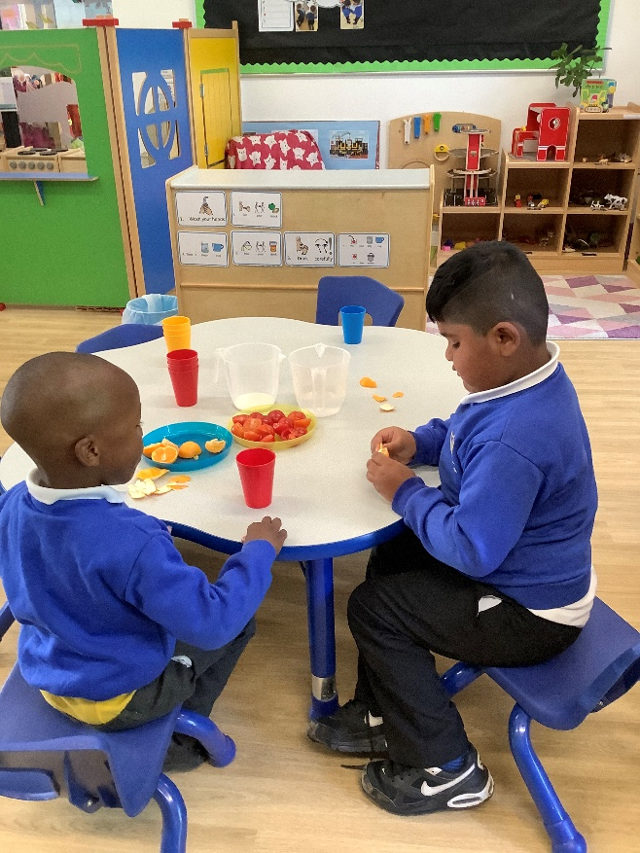
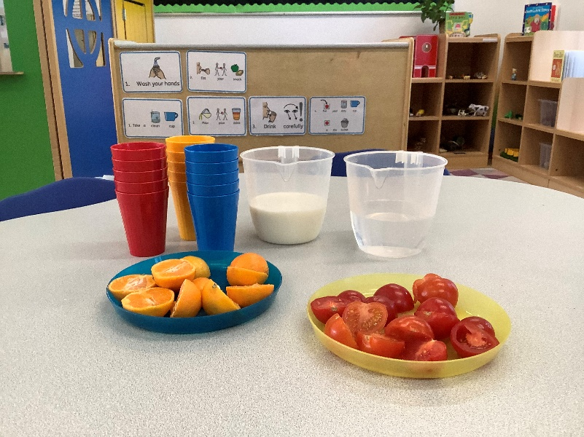
Snacks

Slide 14
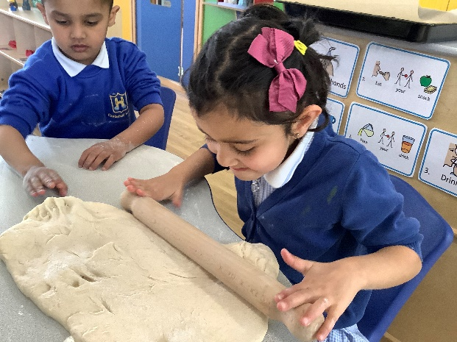
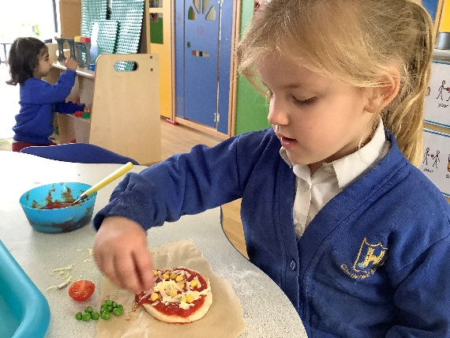
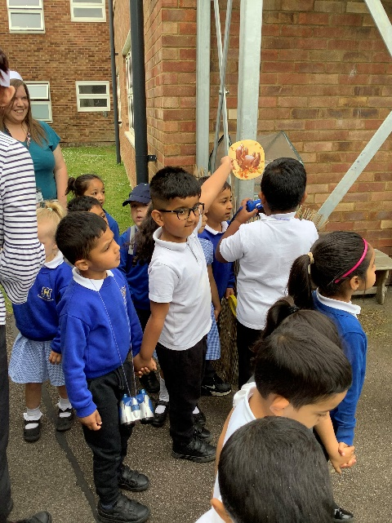
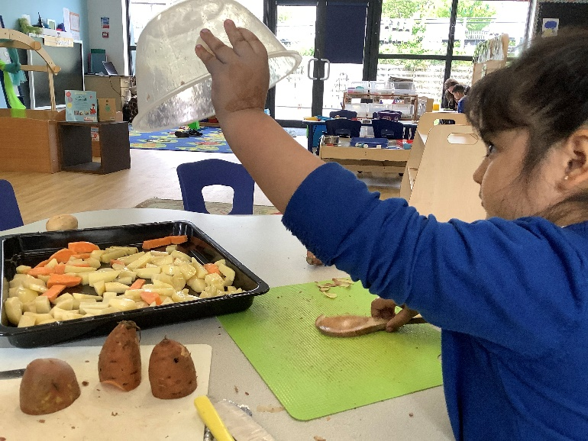
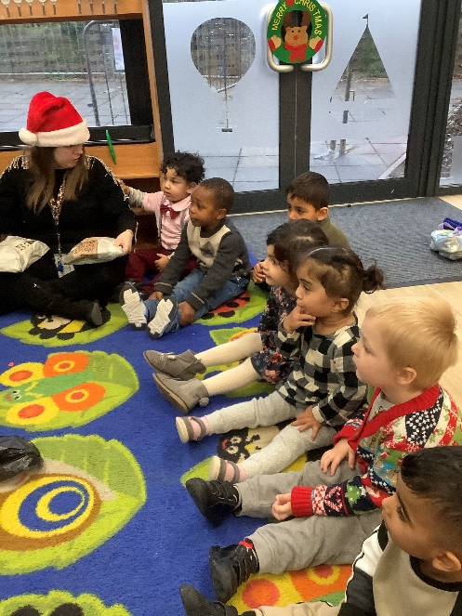
Special Events

Slide 15
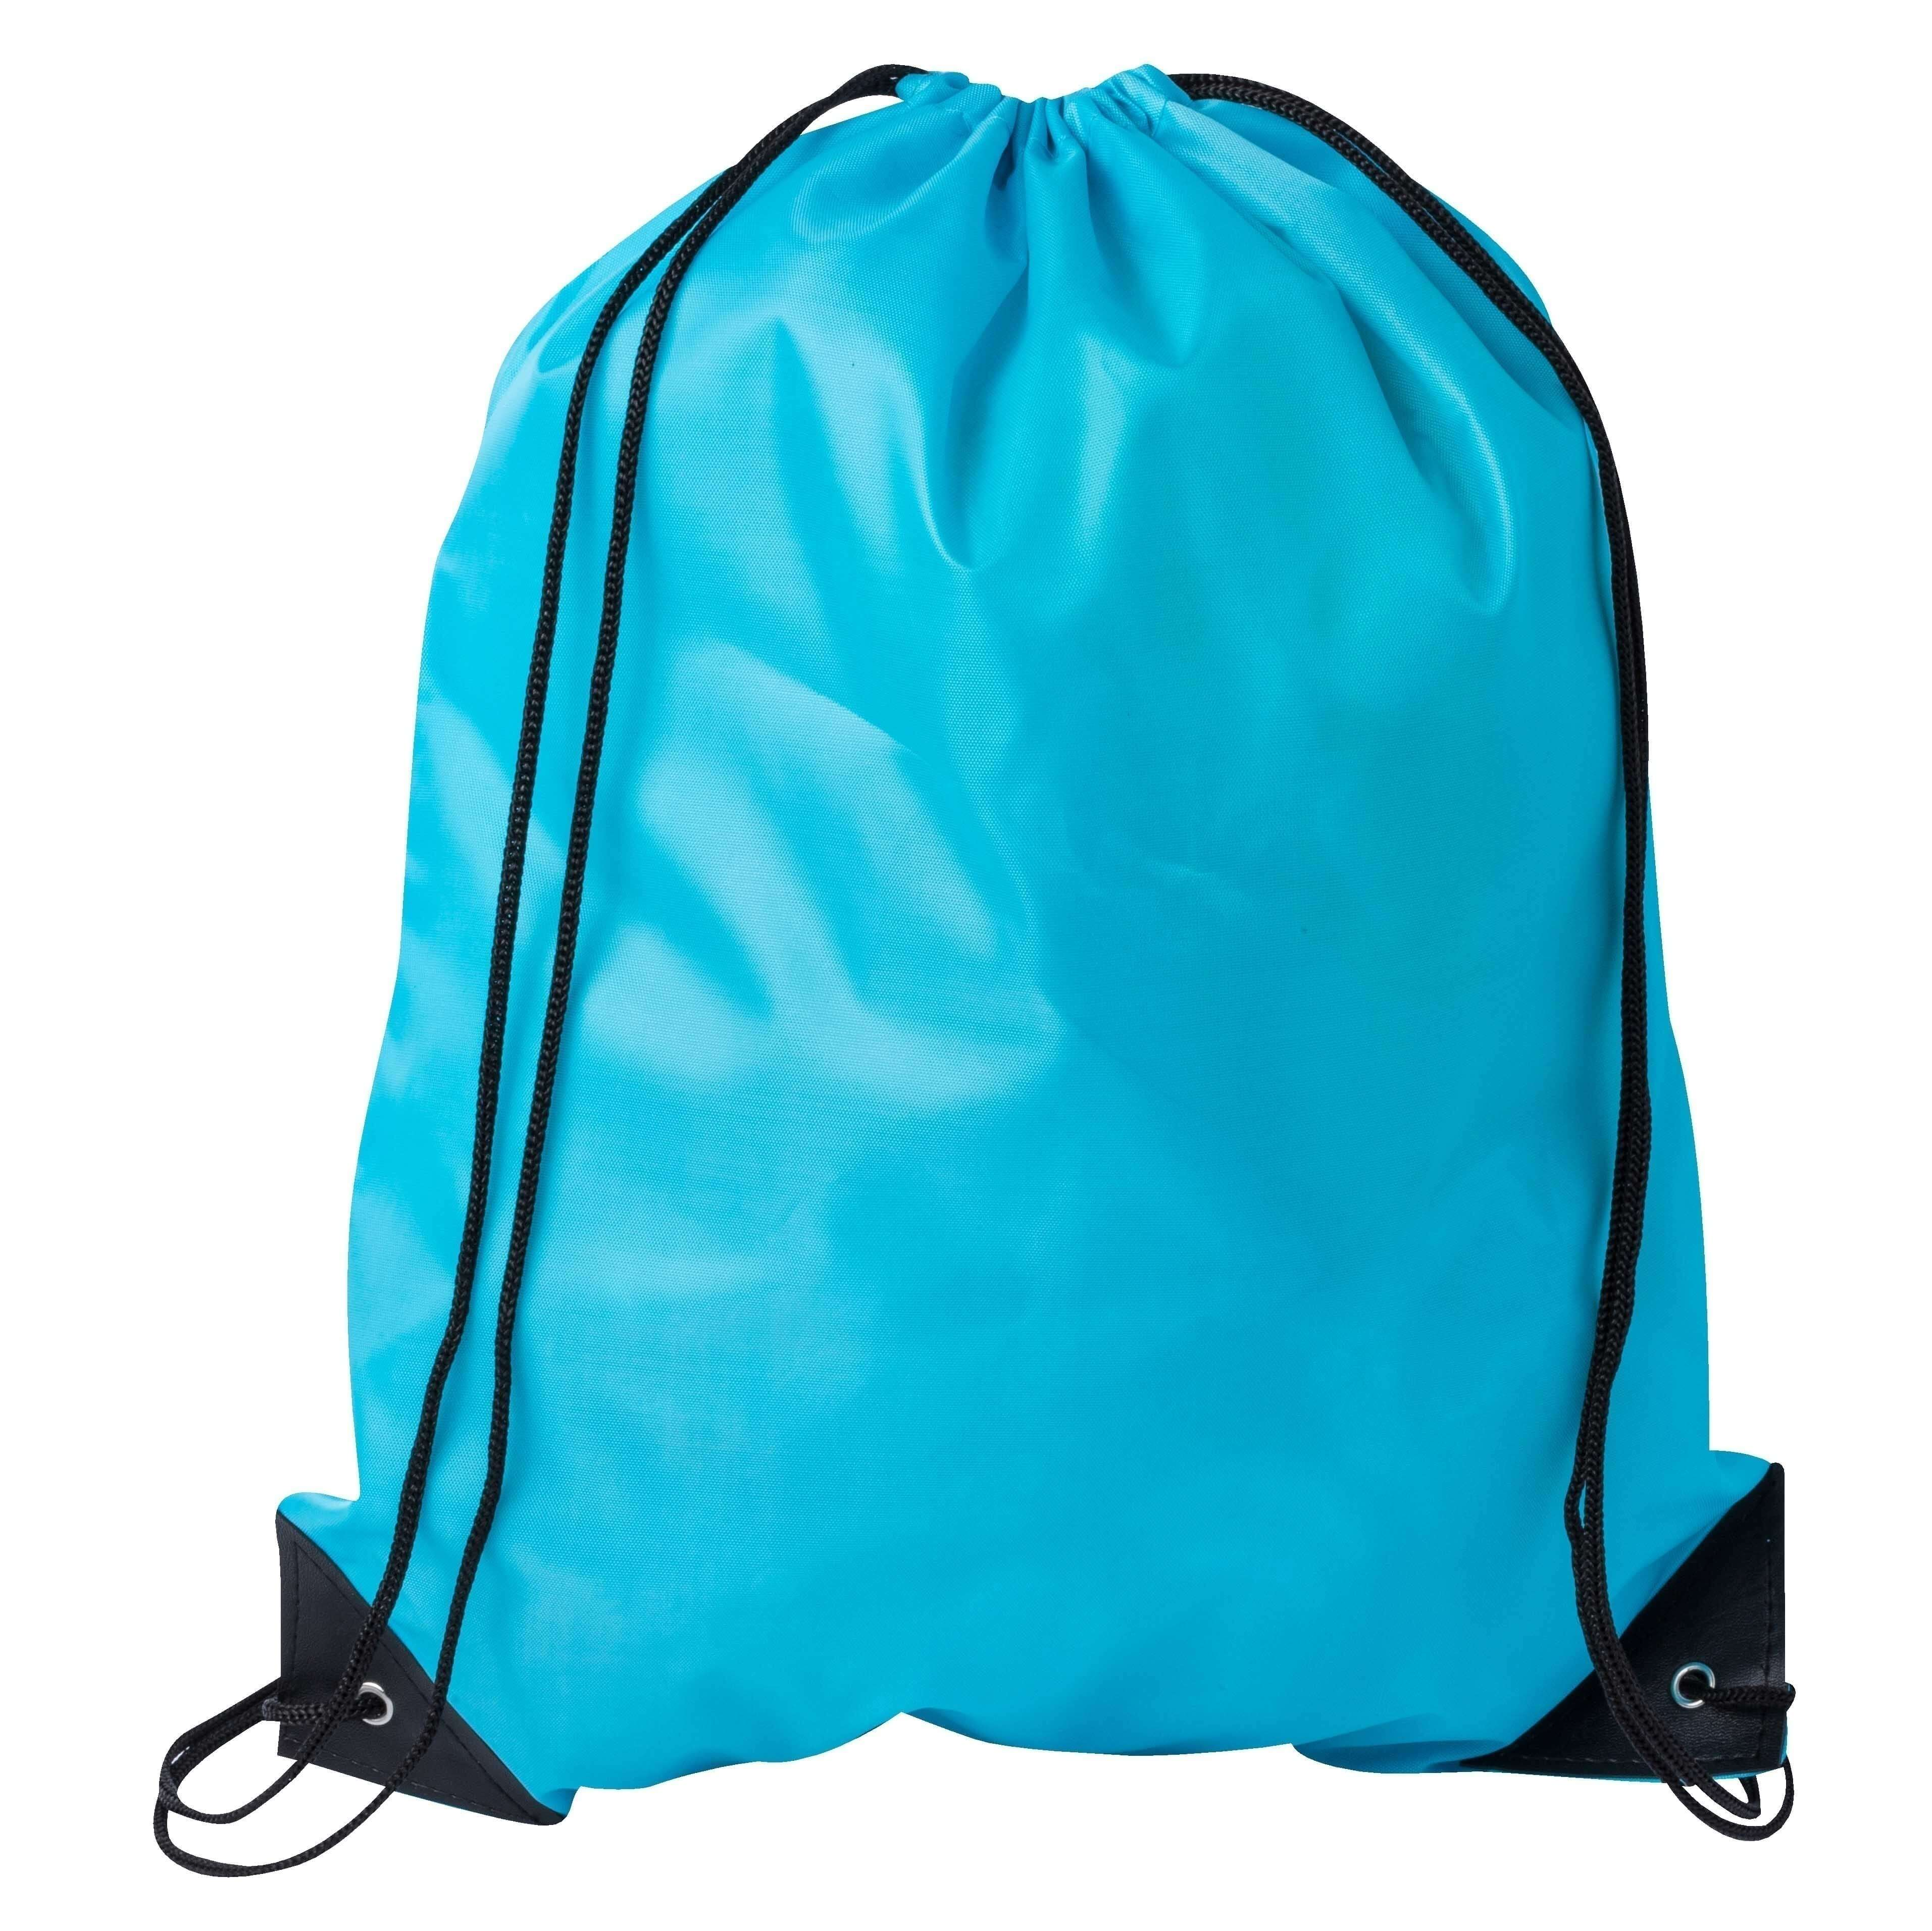
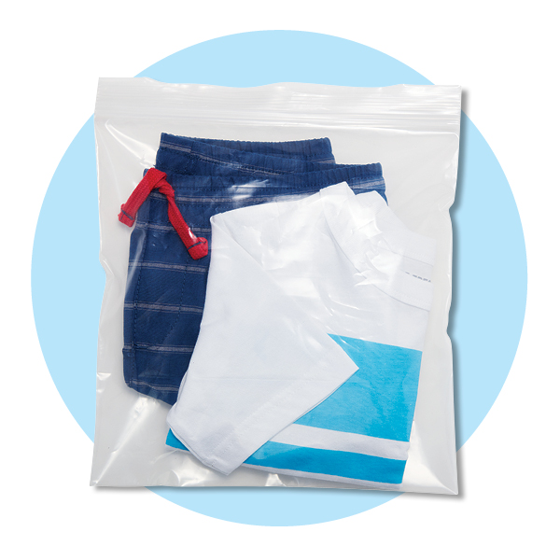
What will my child need to bring to Nursery?
Book bag
Book bag
Drawstring bag
Drawstring bag
Full change of clothes
Nappies and wipes
(if needed)
Full change of clothes
2-3 Year Olds
3-4 Year Olds

Slide 16
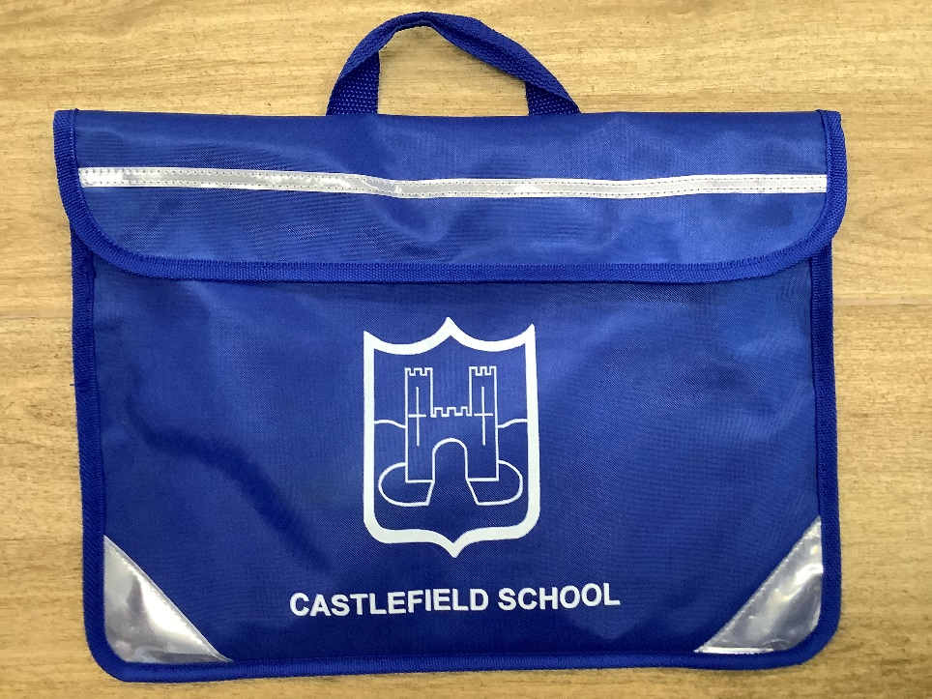
Book Bag

Slide 17
Please don’t bring
Toys from home
Drinks
Food

Slide 18
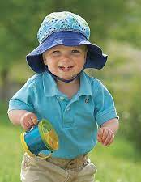
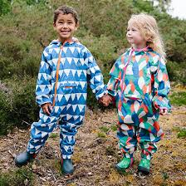
Outdoor wear
Sun hat
Apply sun cream before Nursery
Waterproof coat
&
Wellington boots
Hat, scarf, gloves on a string

Slide 19
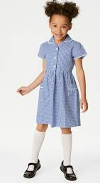
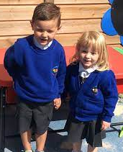
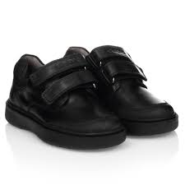
School Uniform
Girls:
White shirt or polo-shirt
Black or grey skirt or trousers/jogging bottoms
Royal blue sweatshirt
Grey or gingham dress for summer
Boys:
White shirt or polo-shirt
Black or grey trousers/jogging bottoms
Royal blue sweatshirt
Grey or black shorts for summer
FOOTWEAR
Shoes should be comfortable, practical and suitable for school use. Black flat shoes only with velcro fastenings.
NO SHOE LACES OR FLASHING LIGHTS PLEASE

Slide 20
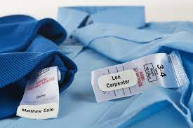
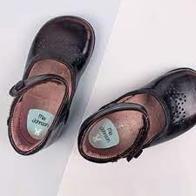
Naming Clothing

Slide 21
Ways to help your children

Slide 22
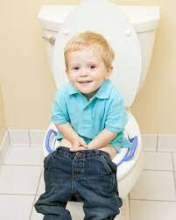
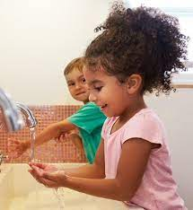
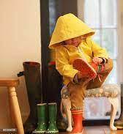
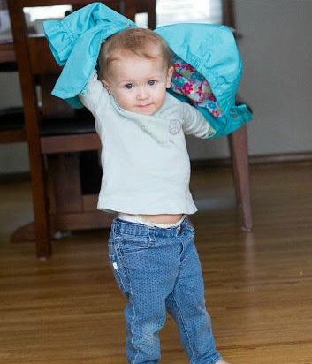
Self Care

Slide 23
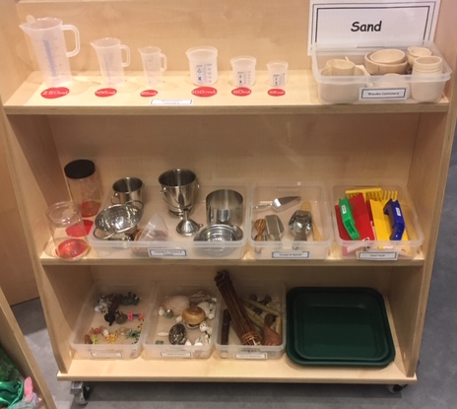
Talking about Nursery
Share a book everyday

Slide 24
Use helpful English words at home
Please
Coat
Help me
Water
Toilet

Slide 25
Parent Support
https://familyinfo.buckinghamshire.gov.uk/
https://www.foundationyears.org.uk/wp-content/uploads/2019/01/What-to-Expect-When-2018.pdf
https://www.castlefieldschool.co.uk/web/year_groups_/224855

Slide 26
Any questions?
Please inform the office immediately if your contact details change.
School Office:
01494 436018
Nursery email:
nursery@castlefield.bucks.sch.uk
Website:
https://www.castlefieldschool.co.uk/web/year_groups_/224855

Slide 27
Notes:
Changes of info to office

